Slide 1


Value engineering
Prepared by Lucie Parrot, eng. M.eng, CVS-Life, FSAVE
February 2019

Slide 2
Value engineering
A methodology aimed at
optimizing the value
of a product, project or process,
existing or under development

Slide 3
Definition of Value
SATISFACTION OF NEEDS
VALUE =
COST

Slide 4
Competitiveness
A business is competitive when:
It designs and optimizes its products and puts them on the market quickly and according to clients’ expectations
It manufactures/builds its products efficiently
It manages its business with optimum processes

Slide 5
Benefits of a team
Knowledge
common
to all
Unique
contribution
Knowledge
shared by
2 members

Slide 6
Implementation strategy
VALUE
ANALYSIS
ADVISED
CLIENT
MARKET
RESEARCH
CONSTRUCTION
NEEDS
DETAIL
ENGINEERING
FUNCTIONAL
ANALYSIS
CONCEPTUAL
DESIGN
FUNCTIONAL
PERFORMANCE
SPECIFICATION
DESIGN TO COST
FMEA

Slide 7
Front loading
More work at the beginning of project
Clear and precise specifications, early on
Goal: reduce rework, redesign, rebuild…

Slide 8
Role of the team members
Each member must bring in his/her expertise in the subject and collaborate during the workshop

Slide 9
The VE Job Plan
1- Organization phase
2- Information phase
3- Function and cost analysis phase
4- Creativity phase
5- Evaluation phase
6- Development and presentation phase
7- Implementation and follow up phase

Slide 10
1- Organization phase
State the object of the study and the reasons for it
Define goals and stakes
Define scope and limits
Identify constraints, means, team member and duration

Slide 11
2- Information phase
Nature of the information:
Technical: reliability, operations, performance, maintenance…
Economical: global costs…
Social: usage, aesthetics, environment, typical client…
legal: safety, guarantees...

Slide 12
3 – Function analysis
Systematic approach used to express the functions a product must fulfil, in terms of usage and not means, to satisfy the user ’s needs.
AFNOR

Slide 13
Function analysis
Function analysis is the prime tool to improve the competitiveness of the…
… products a company designs and manufactures
…buildings a group of architects and engineers design and build

Slide 14
Function analysis
Identify functions: what needs do we have to fulfill? (Verb and noun)
Characterize: performance criteria, levels and flexibility
Organize: what is the logic?
Set into a hierarchy
Analyze costs: cost of functions vs components

Slide 15
Different uses of each method

Slide 16
Functional diagram
Level 1
Level 2
Level 3
Functional group 1
function
function
SOLUTIONS
function
function
Functional group 2
Mission of
product
function
function
function
goal
function
function
function
function
Functional group 3

Slide 17
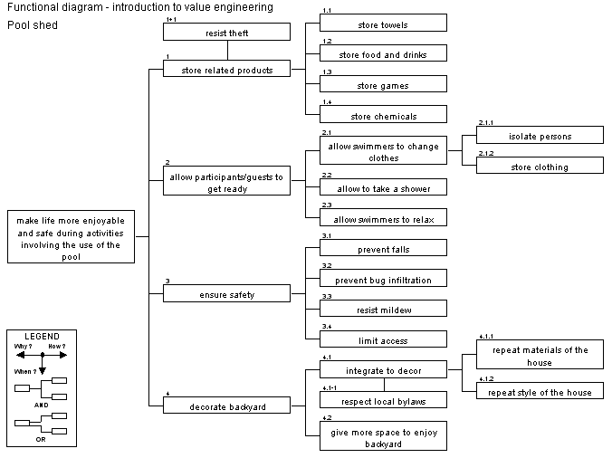

Slide 18
Estimating functions
Give a value to each function:
cost
Square meters
duration
performance
weight...

Slide 19
Results of estimation
Distribute the cost objective on the set of functions
Compare the cost of functions
Validate the interest of the client in paying these costs for these functions
Identify the most expensive functions
Identify mismatches between cost and value

Slide 20
Cost analysis

Slide 21
Results of cost analysis
Distribute the cost objective on the set of functions
Compare the cost of functions
Validate the interest of the client in paying these costs for these functions
Identify the most expensive functions
identify mismatches between cost and value

Slide 22
Cost analysis

Slide 23
Public market
Do commercial activities
Educate population
Attract visitors
Accommodate visitors
Operate market
Ensure health-safety
Encourage social involvement

Slide 24
Functional performance specification
Document by which a client expresses his needs in terms of service functions and constraints
It is the results of the functional analysis
Afnor NF X 50-150

Slide 25
Why a FPS?
Describe the needs in a predetermined format
Indicate grey zones
Identify constraints
Give a response template

Slide 26
Why a FPS?
Let the designer choose freely the best solution
Make the designer responsible for his/her choices
Encourage the client-supplier dialog
Optimize the value of a product
Favour innovation

Slide 27
4 - Creativity phase
Find the most creative and innovative ways other than the actual ones, to perform the functions
Different methods

Slide 28
5 - Evaluation phase
Keep ideas which have great potential in helping us achieve our goal
Group remaining ideas in families
Prepare a development plan for remaining ideas

Slide 29
6 - Development phase
Work on the remaining ideas in order to substantiate the arguments for and against and compare them to the actual situation.

Slide 30
Development phase
Arguments to present:
feasibility
assumptions
advantages and disadvantages
impacts and risks
investments, savings, cost justification
implementation conditions
etc.

Slide 31
Building scenarios
If many proposals can be combined
Always build realistic scenarios
Use a theme
Always compare the scenarios to the global actual situation
Prepare a cost/merit graph of scenarios

Slide 32
Comparing scenarios
Establish comparison criteria and their weight
Evaluate all scenarios and actual situation , on weighted matrix
Evaluate cost of scenarios
Plot cost / merit graph

Slide 33
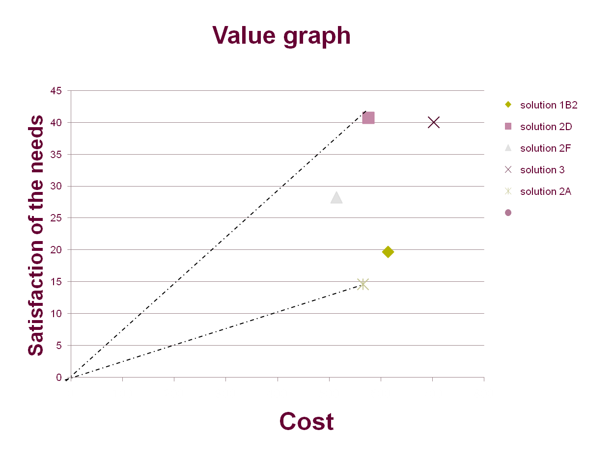

Slide 34
Implementation plan
Compatible with the goals and the culture of the company
Calculate implementation efforts
Evaluate risks of recommendations
Propose a leader

Slide 35
VA / VA Report
Present the results of the workshop, no more no less,
no interpretation from the author,
team report,
clearly recommend a solution,
the client has the last word.

Slide 36
7- Implementation and follow-up
Implement plan accordingly
Concentrate on solutions accepted by client
Name an internal leader and give him/her authority

Slide 37
Different VA projects
Optimization of existing products
Traditional use, cost reduction
Examples:
-Frigidaire -Pratt & Whitney
-Thomas & Betts -ABB
- STM

Slide 38
Different VA projects
New product development:
Expert use, better needs satisfaction, better cost control. Examples:
Bombardier, new snowmobile
Pratt & Whitney, new engine
STM, new train puller
Frigidaire, new stove

Slide 39
Different VA projects
Process improvements:
Expert use, better needs satisfaction, better cost control, time reduction, error reduction.
Examples:
Rio Tinto, new mining facility
Iron Ore of Canada, new mining facility
RT Alcan, new aluminum process
Xstrata zinc, safer transportation of chemicals

Slide 40
Different VA projects
Business processes:
Specialized use, reduction of errors, delay or manpower
Examples:
Hydro-Québec: design of office buildings
ABB: process for proposals
RRQ: resource allocation
McGill: engineering student placement

Slide 41
Different VA projects
Construction projects:
Quebec City Airport, Toronto Airport
Hospitals, health center residence
Bus garage (transit bus, trucks)
New theatres
Refrigerated warehouse
Museums, libraries, public squares
New School of music – McGill
New farmers market
Aquatic centers, sports centers
New intersections

Slide 42
New insectarium

Slide 43
New Insectarium
Context: old building not suitable for a growing collection and growing interest from the public, new building and surroundings to be designed, worldwide architecture contest, won by a German group
Value study: reps from the insectarium, architects and engineers, goal: concept was 14% over budget, find ways to reduce cost while fulfilling needs
Results: proposals for over 15% cost reduction and proposals for 1% cost increase, thus budget was achieved with a better project

Slide 44
Reconstruction of intersection

Slide 46
Intersection
Context: Proposal from traffic experts did not please stakeholders, 2 years of back and forth, no solution in sight. Project manager suggest a value study to find creative solutions
Study: 25 stakeholders around the table! Back to square 1. Best picture of overall needs with function diagram. Many solutions proposed by group
Results: one solution satisfied all the stakeholders, best balance between needs of all. High cost but problem solved.

Slide 47
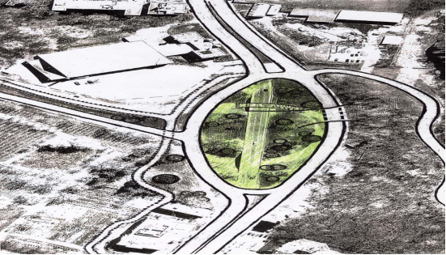
New intersection design

Slide 48
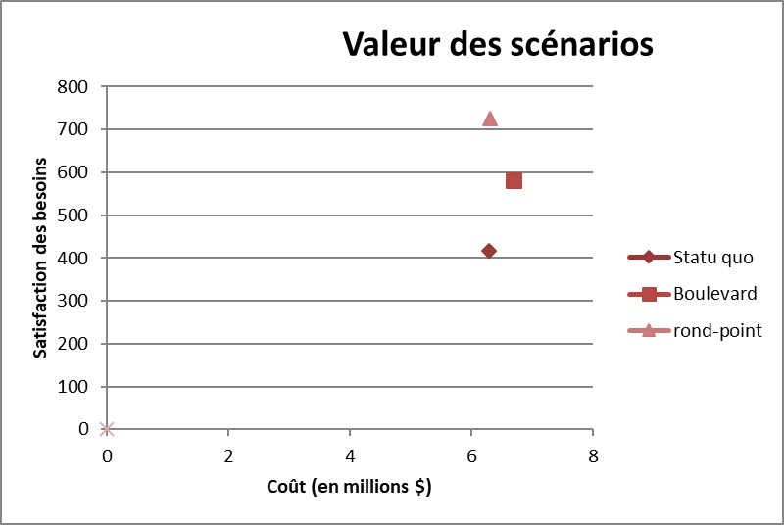
Value graph of intersection designs

Slide 49
Jacques-Cartier square

Slide 50
Jacques-Cartier square
Context: many restaurants have terraces in the summer time, all different styles and location, dismantled every winter. New regulation for location of terrace off the sidewalk, following complaint by wheelchair advocates. The city wanted to be in charge of the terraces.
Study: A proposal from architect was very expensive for the city and refused by the restaurateurs. Goal of value study: find innovative ways to satisfy the city, the users, the restaurateurs
Results: the study showed the life-cycle cost of various options, including a permanent style

Slide 51
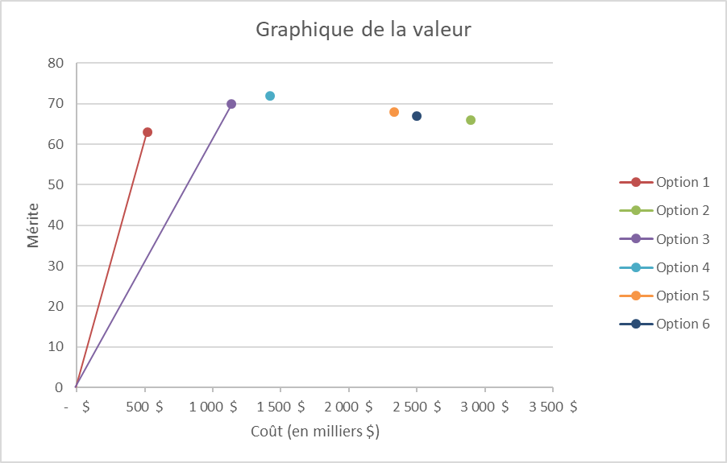
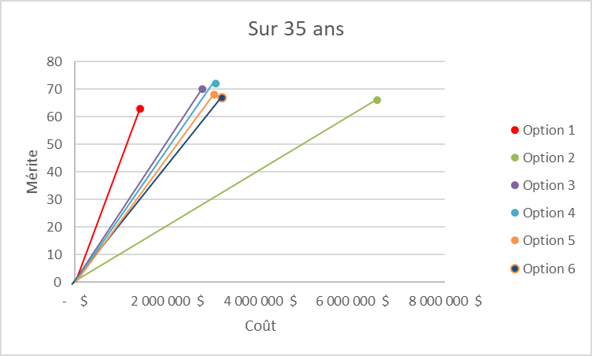
Different types of terrasses
Construction costs
Life cycle costs

Slide 52
Sports center

Slide 53
Ice rink

Slide 54
Ice rink sports complex
Context: developer wanted a specific location for this sports complex, the cost of the structure to accommodate low quality ground was very high, “design-build” team did not want to change design
Study: developer, architect, engineers, came in with half the will to change
Results: a new location was identified and allowed significant cost savings in structure, needs were clearly defined thus project scope was slightly modified

Slide 55
Museum of modern art

Slide 56
House of litterature

Slide 57
Nunavut health center
Context: a health center was designed to be built in 3 locations; after the 1st one built and occupied, nurses started to complain about the many steps in the residence
Workshop: professionals and nurses analyzed the design to improve how it would fulfill the needs, which were not very well captured first
Results: a more flexible construction with much better satisfaction was identified, at the same cost

Slide 58
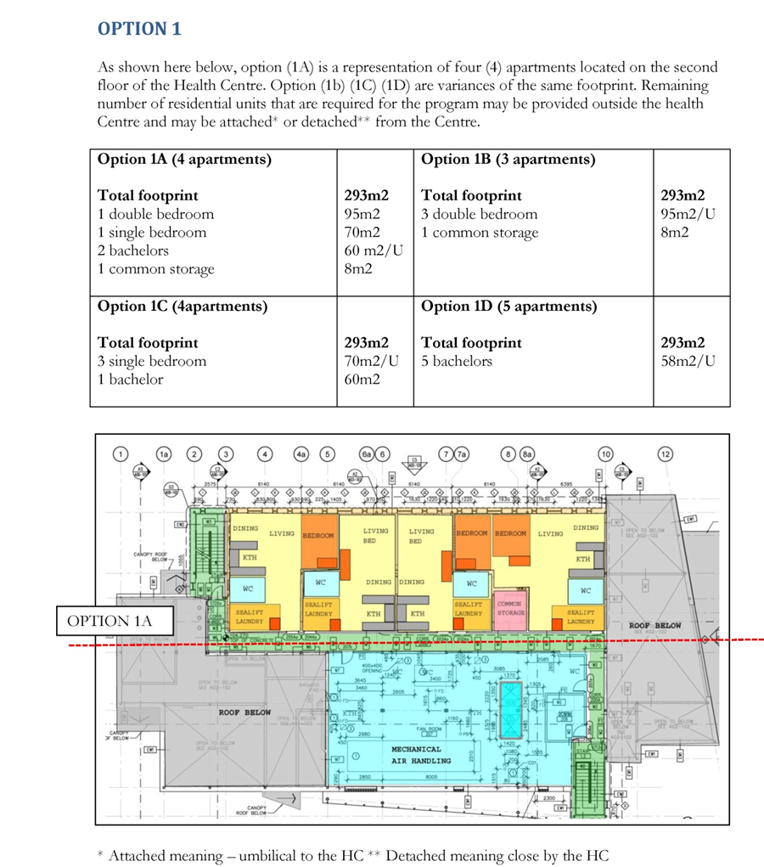
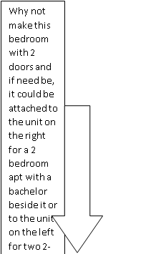

Slide 59
Transformation of church

Slide 60
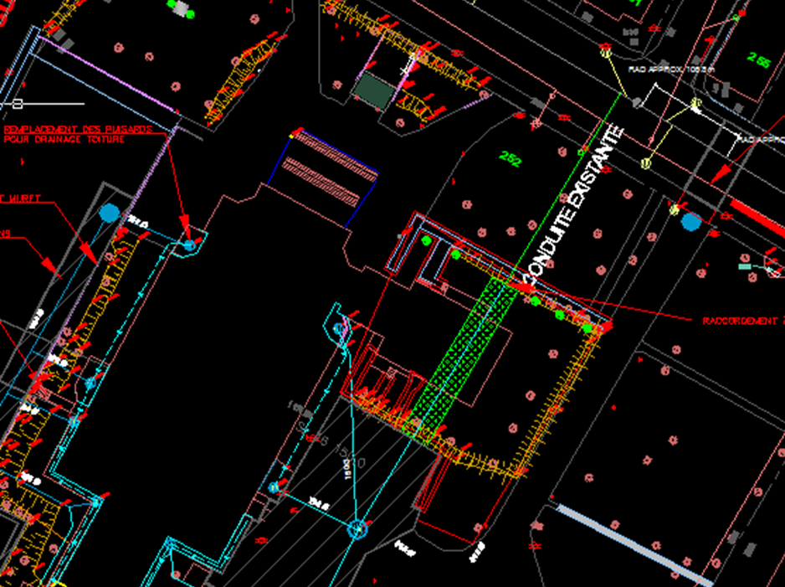
Outside the church

Slide 61
Other uses of VA
When competition announces a new menacing product/project
Risk associated to a new product
Significant stakes, monetary or technologically

Slide 62
Key success factors of VE
Pilot Project choice
Team spirit
Open mind
Use of a moderator
Support for implementation

Slide 63
Key success factors of VE
Pilot Project choice:
choose a project carefully
do not exaggerate at the beginning
agree on scope
set limits and constraints
define expectations

Slide 64
Key success factors of VE
Team spirit
full membership
subject matter experts
no boss-employee relations
shared work and benefits

Slide 65
Key success factors of VE
Open mind:
Accept innovation
Accept all points of view
Do not censor or criticize

Slide 66
Key success factors of VE
Use a moderator/facilitator:
Train an employee fit for it
Use the services of a specialist
Never wear 2 hats (participant and moderator)
Trust the job plan

Slide 67
Key success factors of VE
Support implementation:
Give it a chance
Name an internal leader
Give him/her all the required power

Slide 68
Benefits of VE
Competitive products and services
Better communication
Reduced or controlled costs
More efficient teams
Development of individuals and teams
Better project control

Slide 69
Conclusion
VE is a tool for competitiveness: satisfaction of needs at the lowest cost
VE can be used for buildings, infrastructures, products, services, processes, etc.
VE can be used at all phases of the life cycle of the “product”, the best being as early as possible

Slide 70
Project management
REDUCE RISK
MAXIMIZE PROFIT
Define
Plan
Execute
Control
Close
TASK DELIVERED
Resources
scope
time
money
TASK GIVEN
Three pillars

Slide 71
Project management
Understand the initial requirements
Plan and set feasible and reachable targets
Create a balance between the quality, time, cost, demand and scope
A science and an art of organizing all the components of the project

Slide 72
How can VE help?
SCOPE
Definition of Value
Satisfaction of needs
Value =
Cost (resources)
MONEY

Slide 73
Value engineering job plan
Pre WS
What is the goal of the VE session and why?
Workshop
Function and cost analysis
Post WS
Implement best proposals
Follow up
Who will participate?
Creativity and evaluation
Development of Value proposals and presentation
FACILITATED PROCESS

Slide 74
How VE helps define scope
Function analysis
Identify functions
Organize functions
Characterize functions
Prioritize functions

Slide 75
Example
Design and construction of a new building:
The user
The owner
Operations
Maintenance
End of life

Slide 76
Example
Danse school
Receive students (users)
Minimize noise transmission
Symbolize movement
Show progress (parents)
Accommodate teachers (users)
Control temperature(operations)
Ensure security (operations)
Have access to roof (maintenance)

Slide 77
Characterizing functions
Function | Criteria | Level | Flex
Receive students | Number of students at a time | 100 | max
Show progress | Occurrence Number of visitors | Once a year 250 | F0 F2
Accommodate teachers | Number of teachers | 6 | F1
Control temperature | Studios Offices | 18 degrees C 20 degrees C | F1 F1
Have access to roof | Type of access | Direct, assisted | F0
Ensure security | Level | Typical school | F0

Slide 78
Results?
You understand your client’s business better
You know what your project must deliver
You can allocate resources accordingly

Slide 79

Results?
Now you have scope!

Slide 80
Let’s go on!
SCOPE
Satisfaction of needs
Value =
Cost (resources)

Slide 81
Finding the best project
Function analysis
Identify needs
Functions – criteria – level -FLex
Creativity
Find all options (concepts)
Estimate the cost of options
Value graph
Select comparison criteria
Evaluate options = level of satisfaction
Plot on graph: Level of satisfaction/cost

Slide 82
Value graph

Slide 83

Now, what else?
scope
time
money
Three pillars
What about time?

Slide 84
Time savings
Better understanding of wants and needs and nice-to-have
Less back and forth with client
No over design
No under design
Better resource allocation

Slide 85
Project management
REDUCE RISK
MAXIMIZE PROFIT
Define
Plan
Execute
Control
Close
TASK DELIVERED
scope
time
money
TASK GIVEN
Three pillars

